Slide 1
Time Management
By Connor Tisdel, Arya Ramchandani, Chance Smith, Alvis Ngan, Alvin Ewaldo, Guanhua Tao and Haram Moon

Slide 2
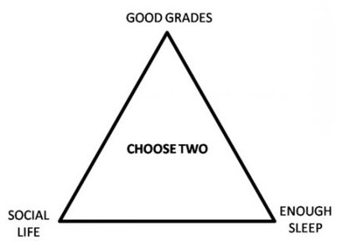
Introduction
Many students struggle with managing their schedules when they get to college
There are a variety of things to take into account
Leisure activities
Sleep
Study
2 hours per credit hour is widely known as the best ratio for study time
This program give the user suggestion time of studying based on his/her schedule, including sleep and leisure activities, everyday.
This is where problems arise

Slide 3
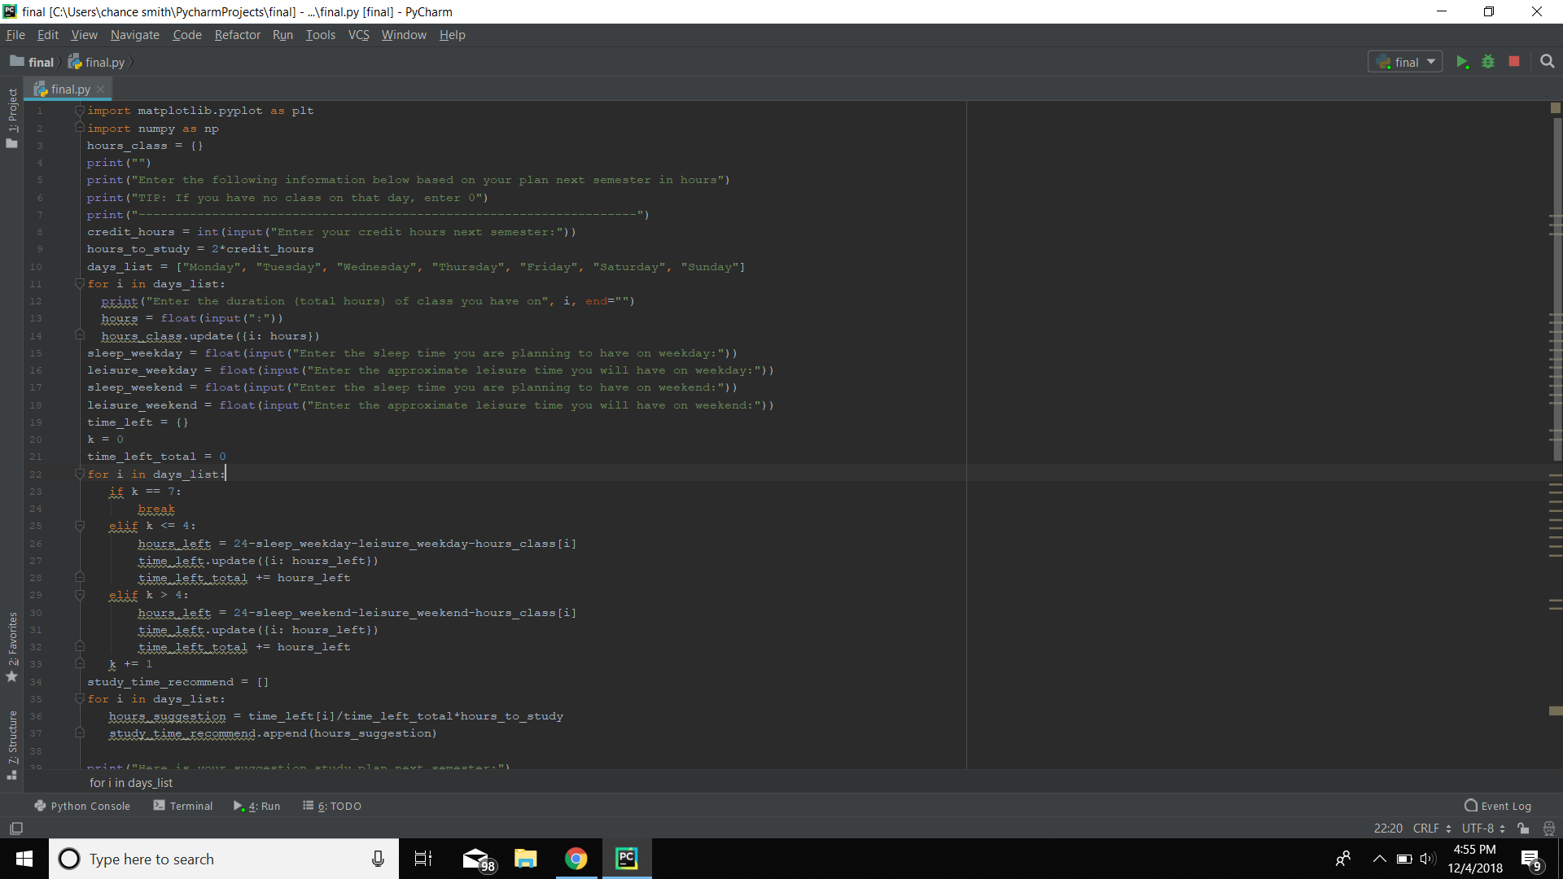
Program 1
Has the user input. . .
Credit hours
Class time per day
Leisure time per day
Sleep per day

Slide 4
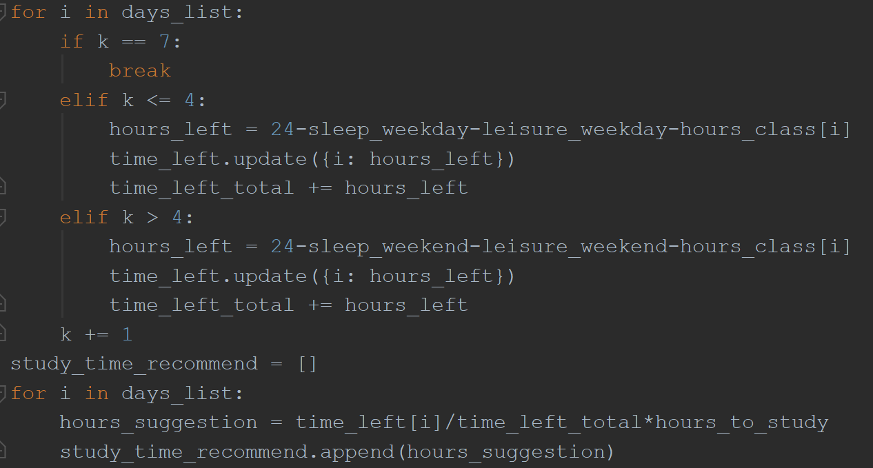
Calculates time left per day after. . .
leisure
sleep
class time
The second loop calculates the suggested study time based on the first loop’s calculation

Slide 5
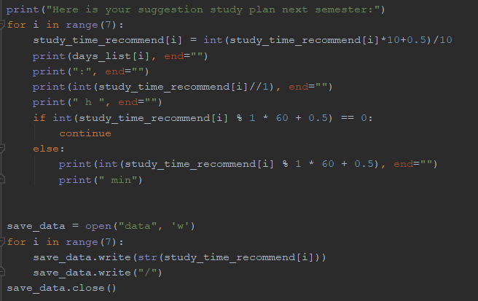
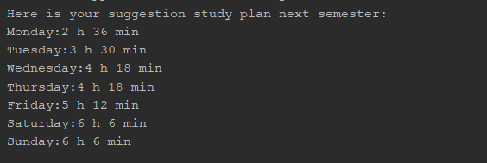
This part of the code prints out the recommended hours of study time.
“3 hours and 30 minutes”
“3h 30 min”
After the loop, the code will create a file.
Write in the recommended hours of study time separated by “/”.

Slide 6
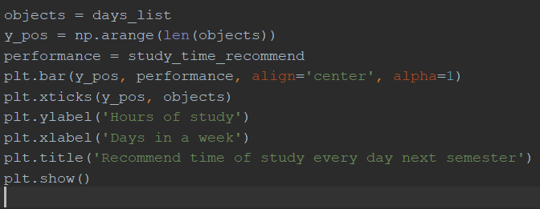
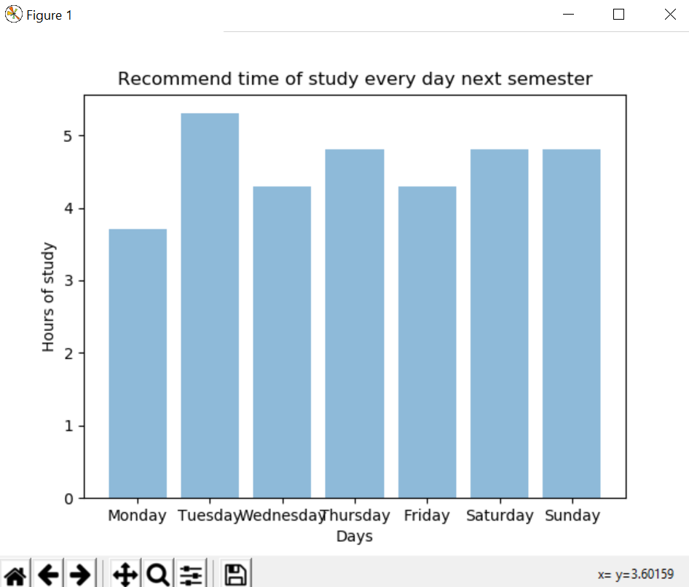
Bar Graph
Output:
These lines of code creates a bar graph.
x/y labels
Bar graphing
titles

Slide 7
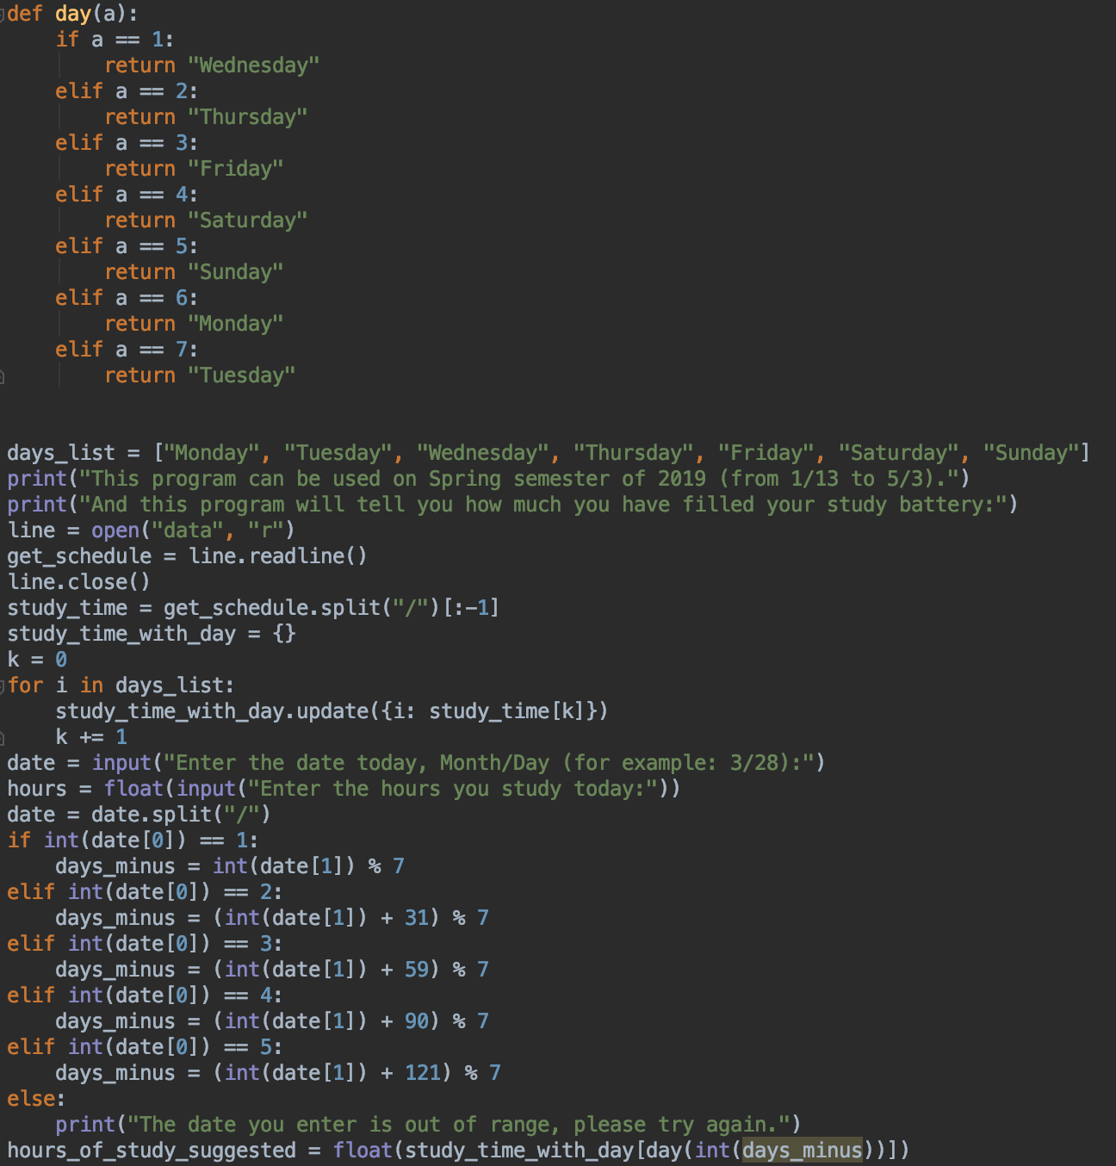
Program 2
In this part of the program...
user is asked to enter the date from next semester and how many hours they study on that day.
It also read the suggest_study_time, from Monday to Sunday, from program 1
By getting the date, it converts that date into the days in the week (ex. Converting 2/16/2019 into Wednesday)
And by knowing the days in the week and suggest_study_time everyday, it will process out the suggest_study_time on the date you entered

Slide 8
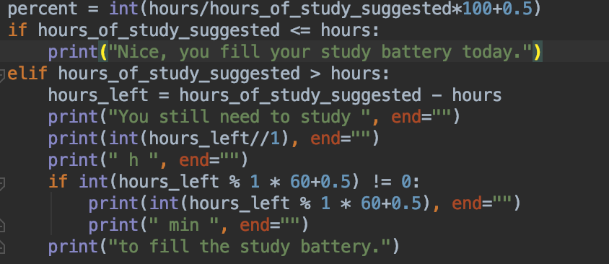
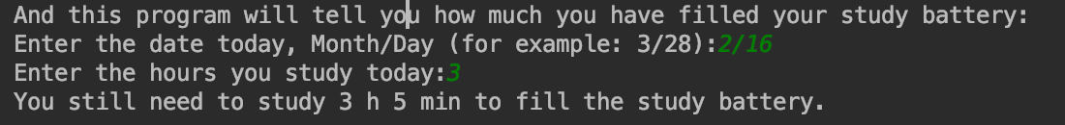
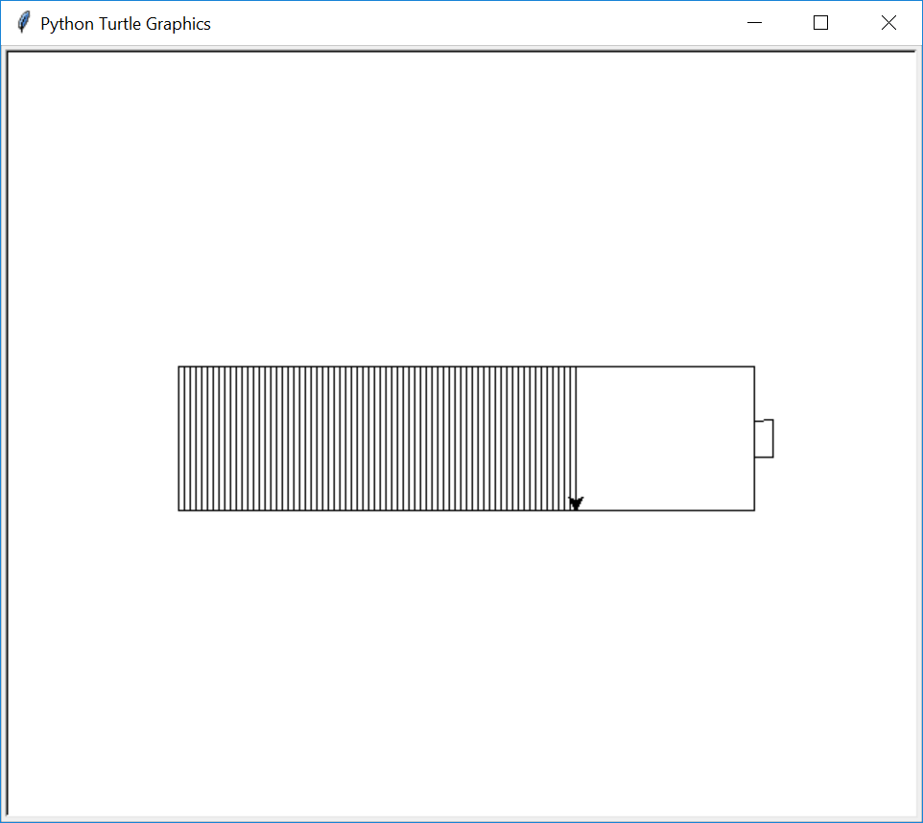
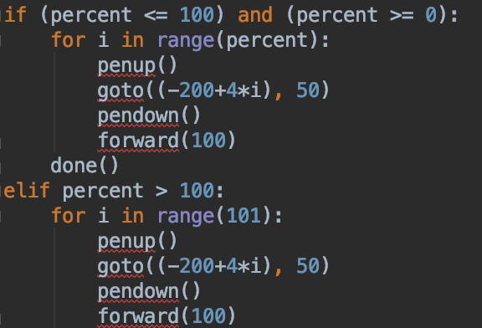
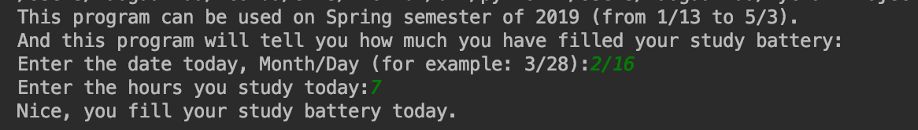
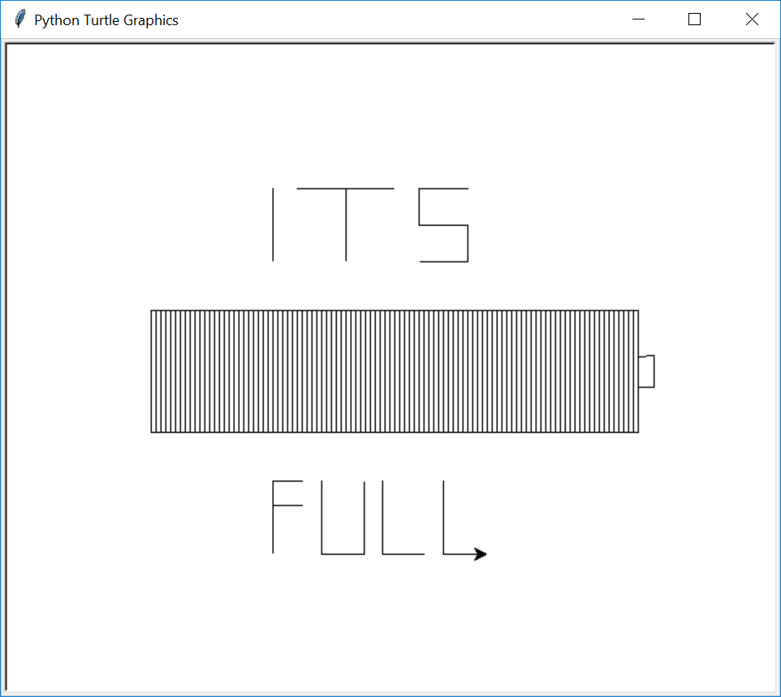
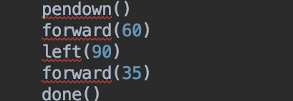
Example 1
Example 1
…..
------ 60 more lines of turtle-----------
Example 2
Example 2

Slide 9
Thank you for paying attention. Question time

